Slide 1
All You Need to Know About Model Predictive Control for Buildings
Authors: Ján Drgoňa, Javier Arroyo, Iago Cupeiro Figueroa, David Blum, Krzysztof Arendt, Donghun Kim, Enric Perarnau Ollé, Juraj Oravec, Michael Wetter, Draguna L. Vrabie, Lieve Helsen
Institutions: PNNL, KU Leuven, EnergyVille, VITO, LBNL, SDU, Purdue, STUBA

Slide 2

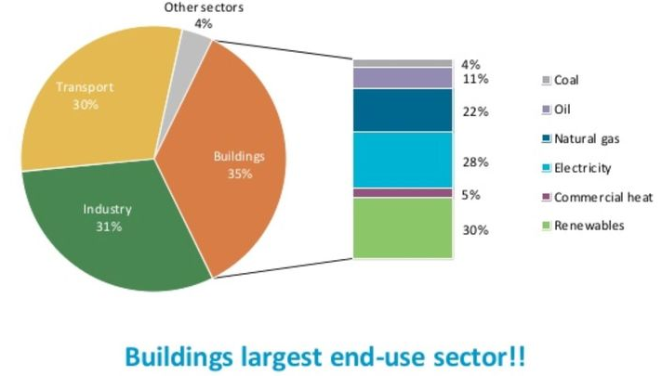
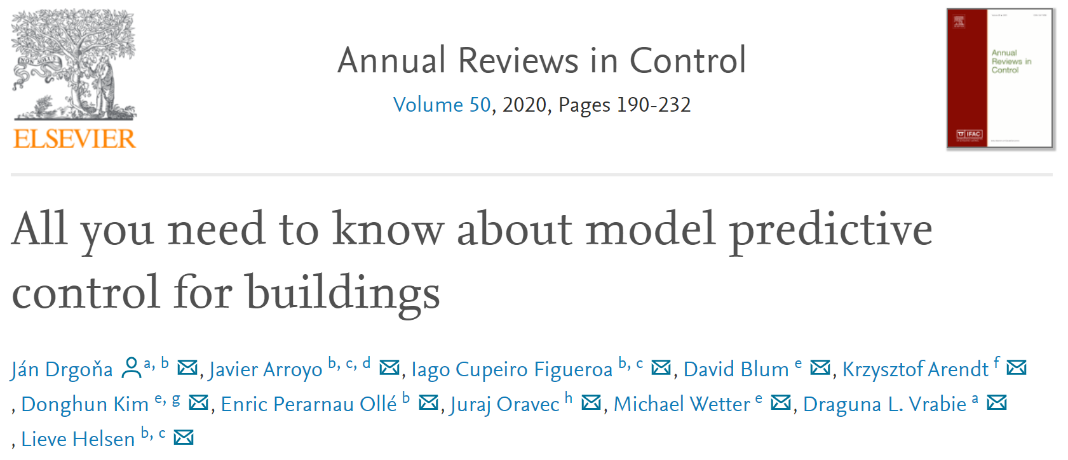
Motivation
Advanced control methods can notably reduce energy use and mitigate GHG emissions of building with average energy savings of 13% to 28%.
However, there are significant barriers when it comes to technology adoption in practice.
Our paper provides comprehensive interdisciplinary overview of advanced building control technology with the focus on real-world applications.
International Energy Agency (IEA), Energy Technology Perspectives 2014 https://www.iea.org/reports/energy-technology-perspectives-2014
Notes:
Out motivation starts with the impact the modern buildings have on global energy and climate. Our Ambition was to provide Unifying framework integrating both theoretical and practical aspects of the technology
Single publication for guiding the whole process of implementation of MPC in real buildings

Slide 3
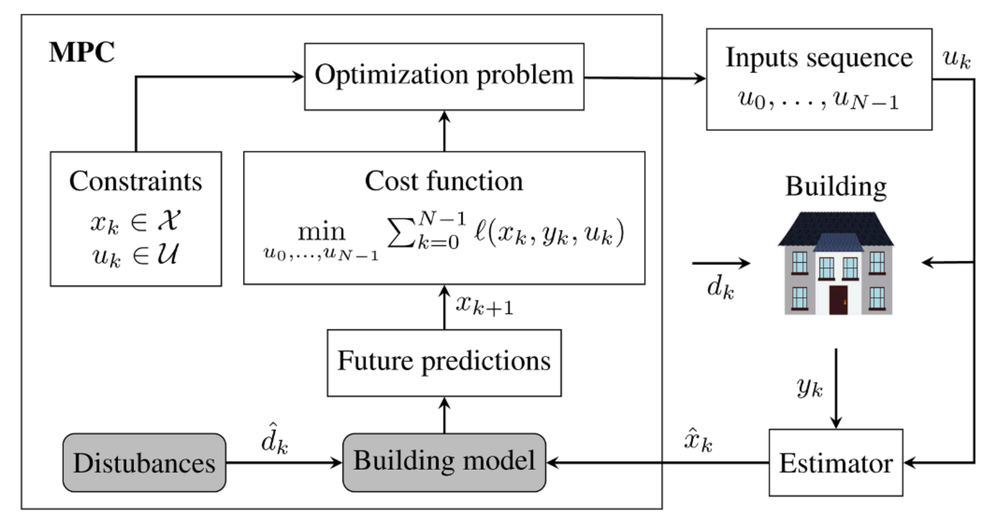
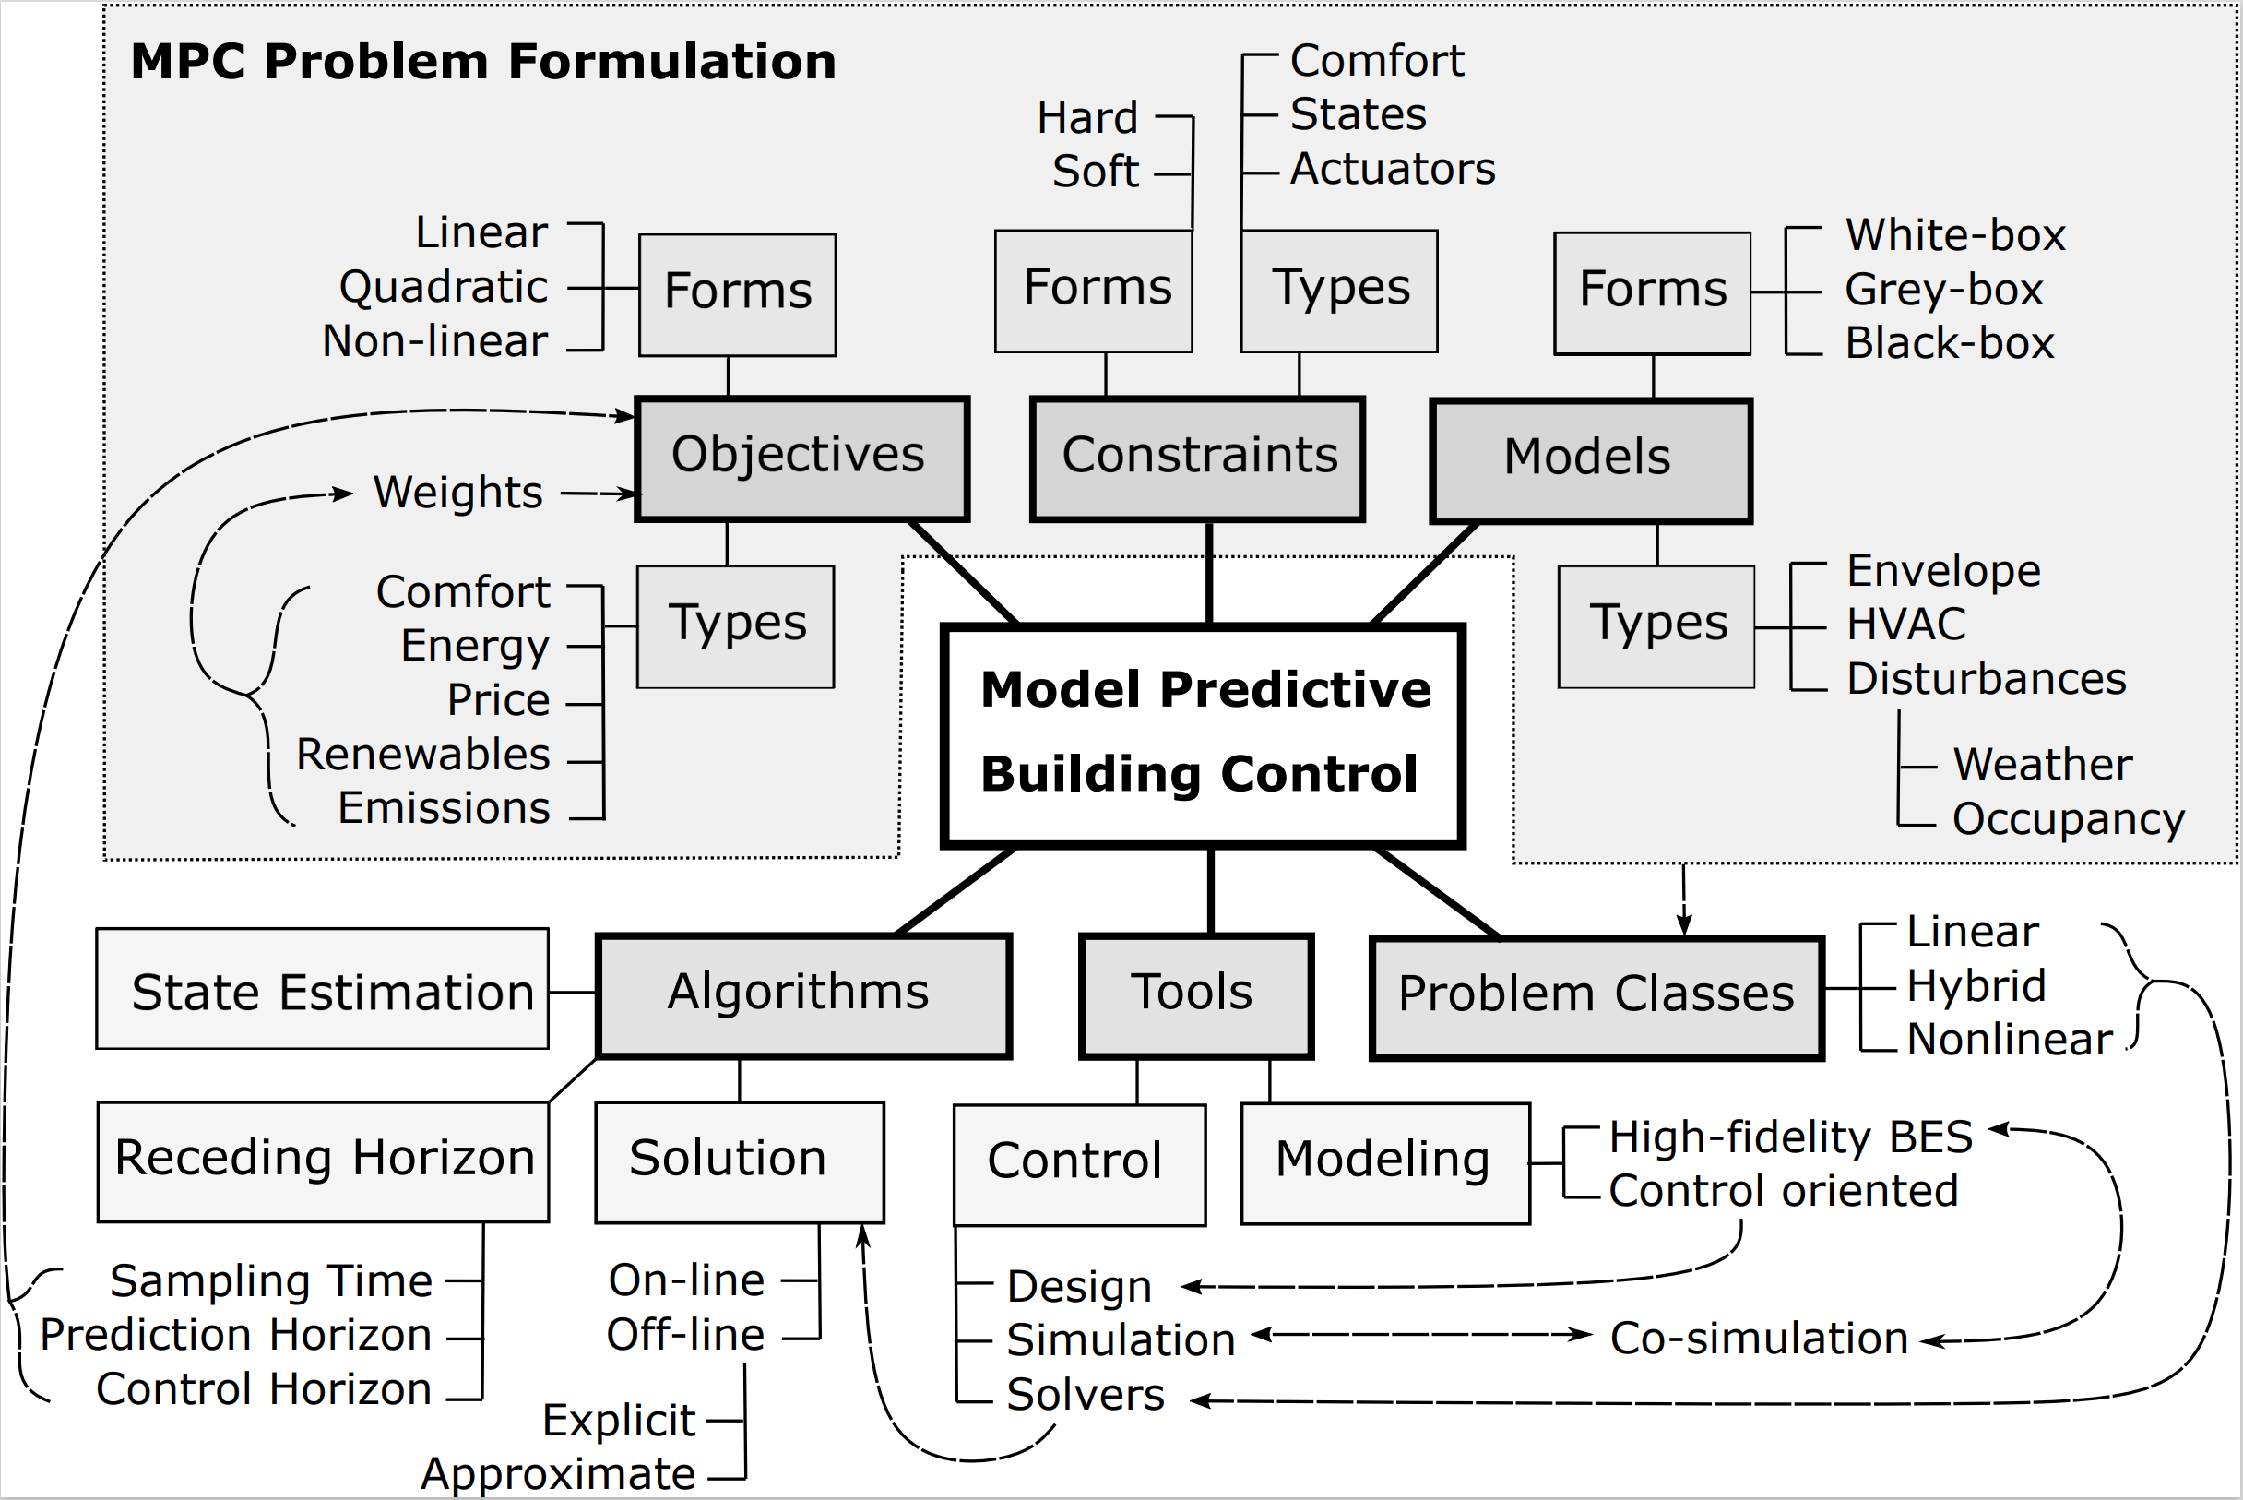
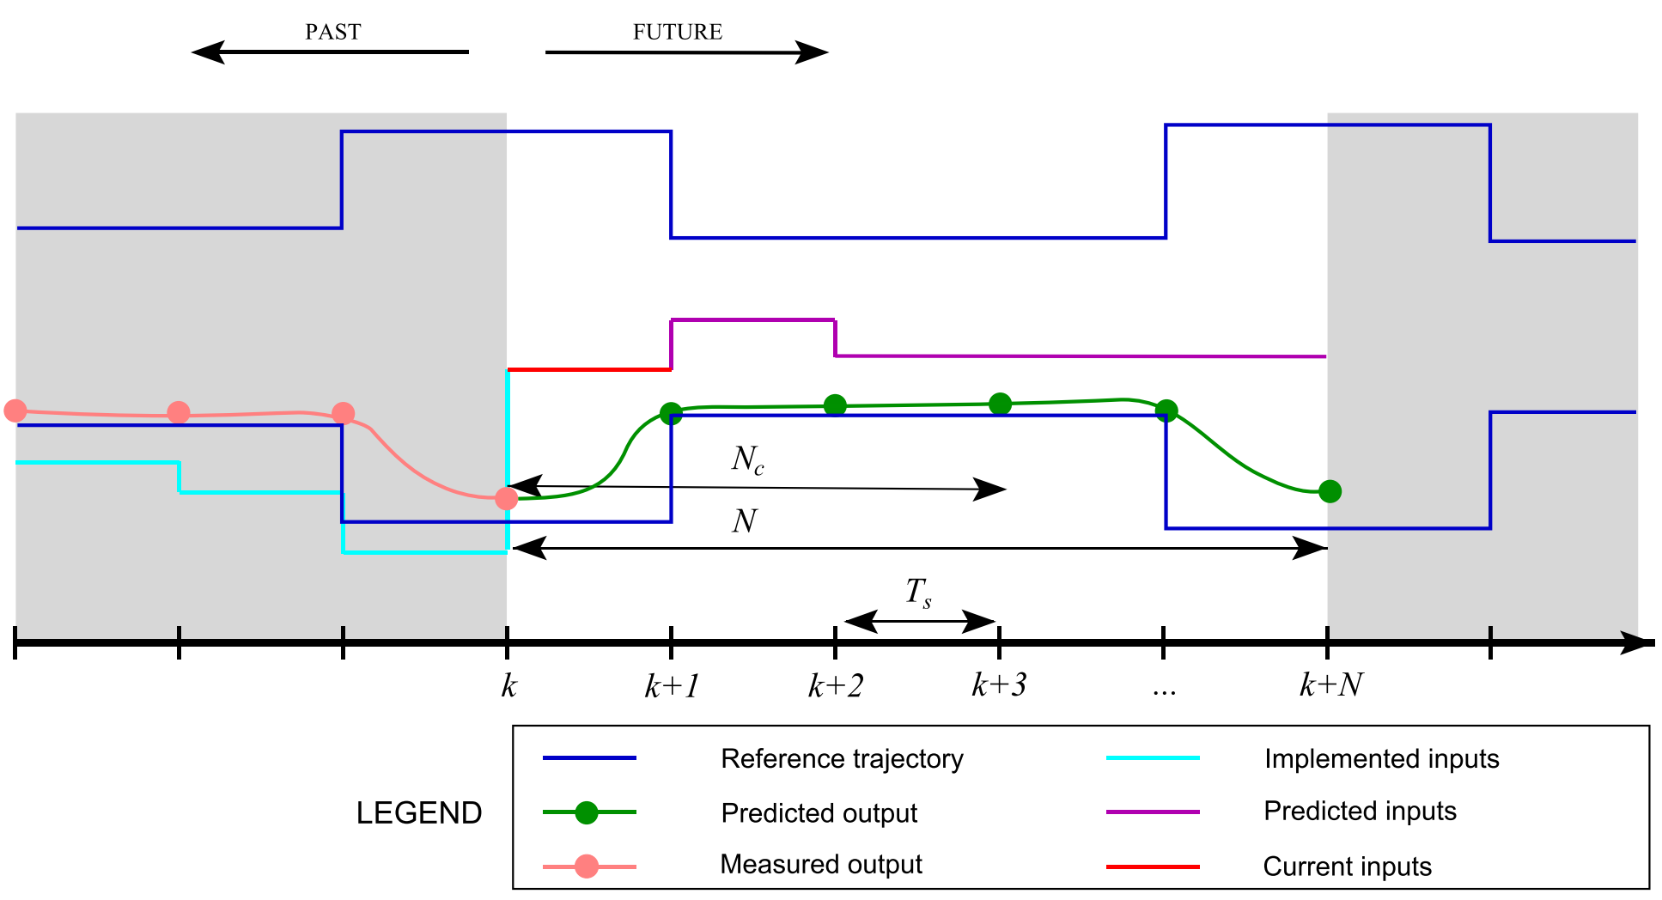
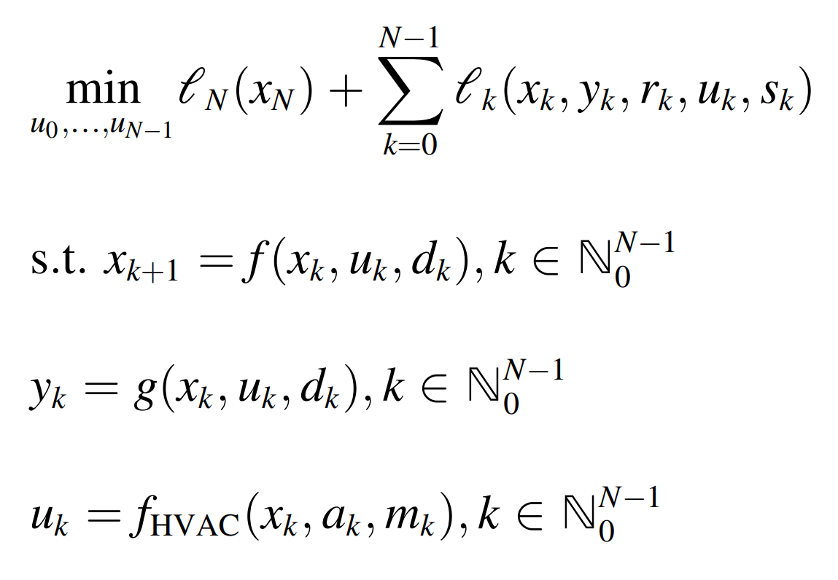
All You Need to Know About Model Predictive Control
Notes:
Our paper starts with introduction of control theoretic concepts and detailed review of MPC technology
Explaining topics such as: Closed loop diagrams, Principles of predictive control, state estimation, optimization-based control
Components of predictive control: objectives, constraints, models, formulations, uncertainty quantification and mitigation, solution algorithms

Slide 4
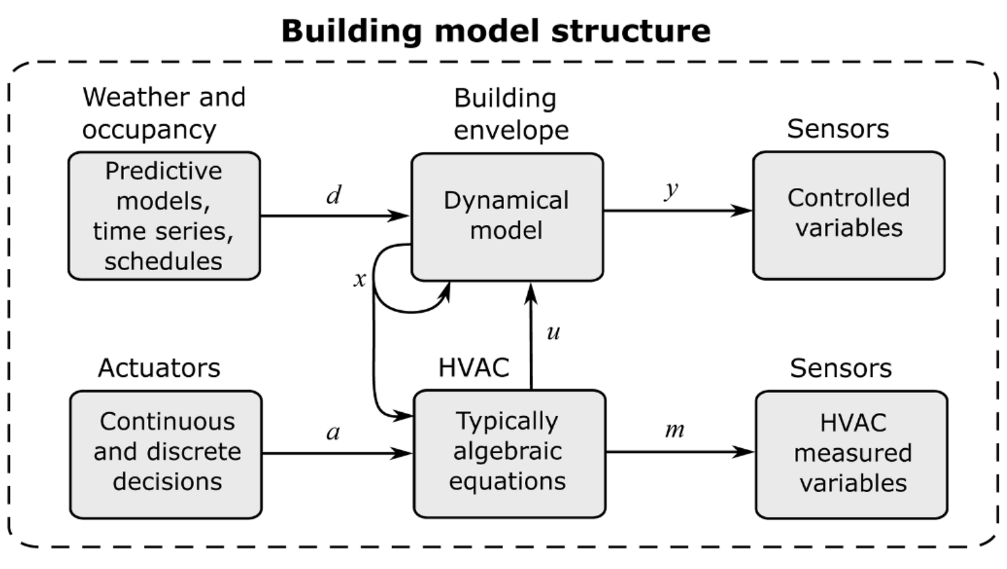
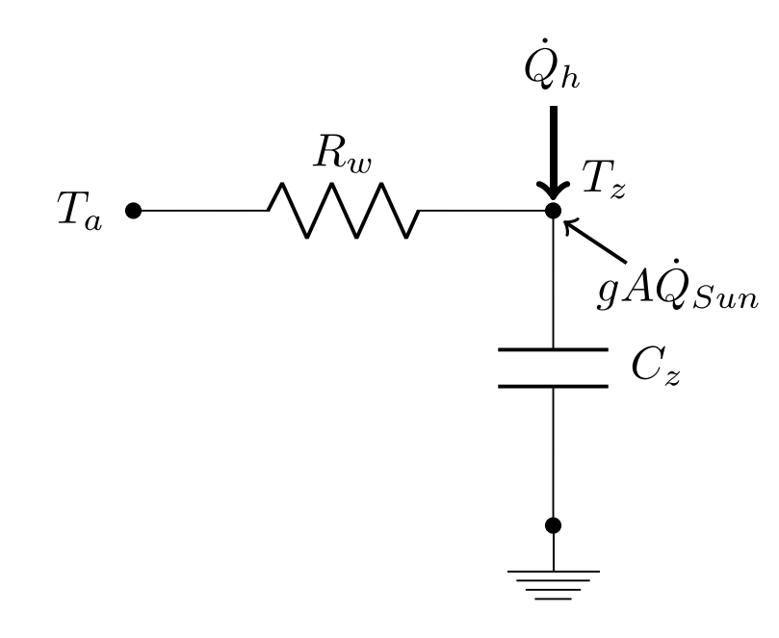
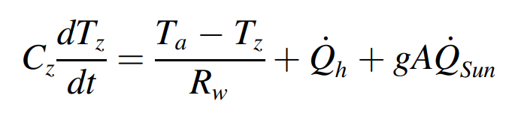
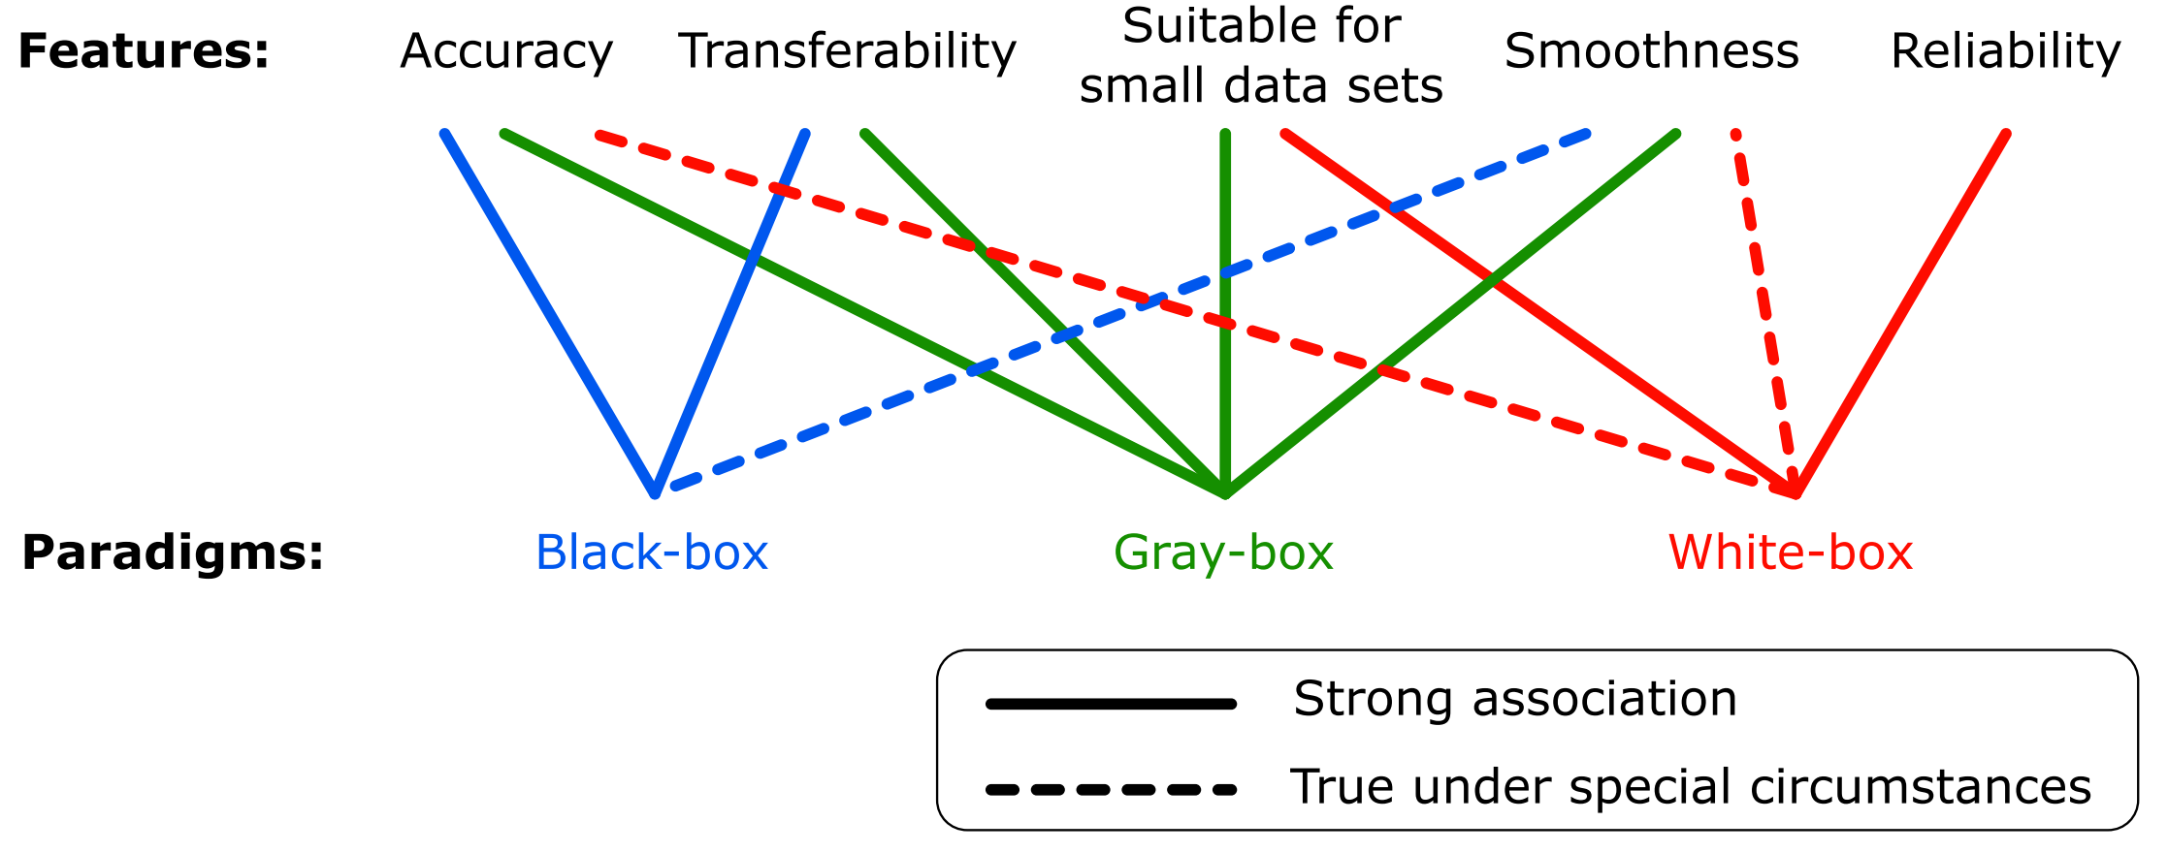
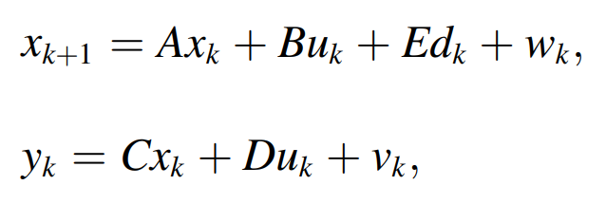
All You Need to Know About Building Modeling
Diagrams:
Equations:
Control models:
Notes:
Core component of MPC: models of building physics/thermal dynamics – its development is also one of the main bottlenecks
MPC performance depends on model accuracy and reliability
Sound tradeoff between model accuracy and simplicity is required for MPC solvers
In our paper we review and compare different modeling paradigms: black gray and white box approaches we provide complete modeling framework starting with real building -> equipment components -> eng. diagrams -> physics equations -> control oriented models

Slide 5

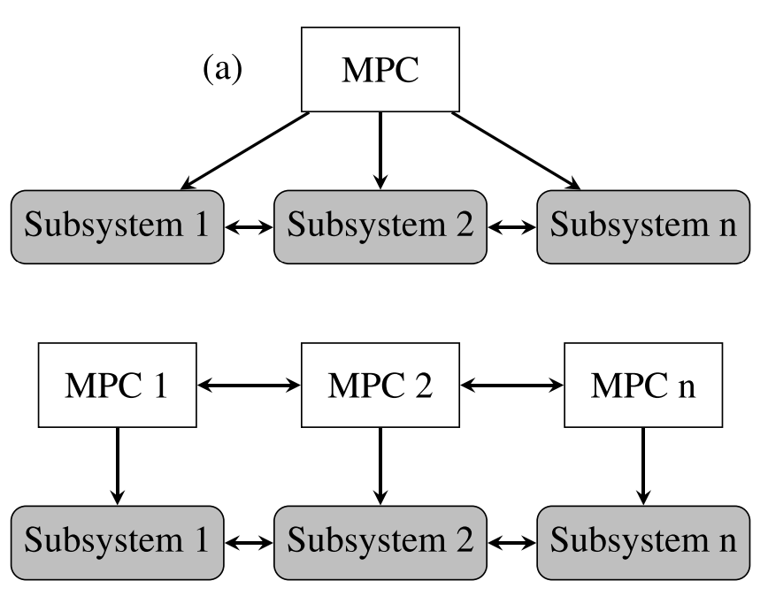
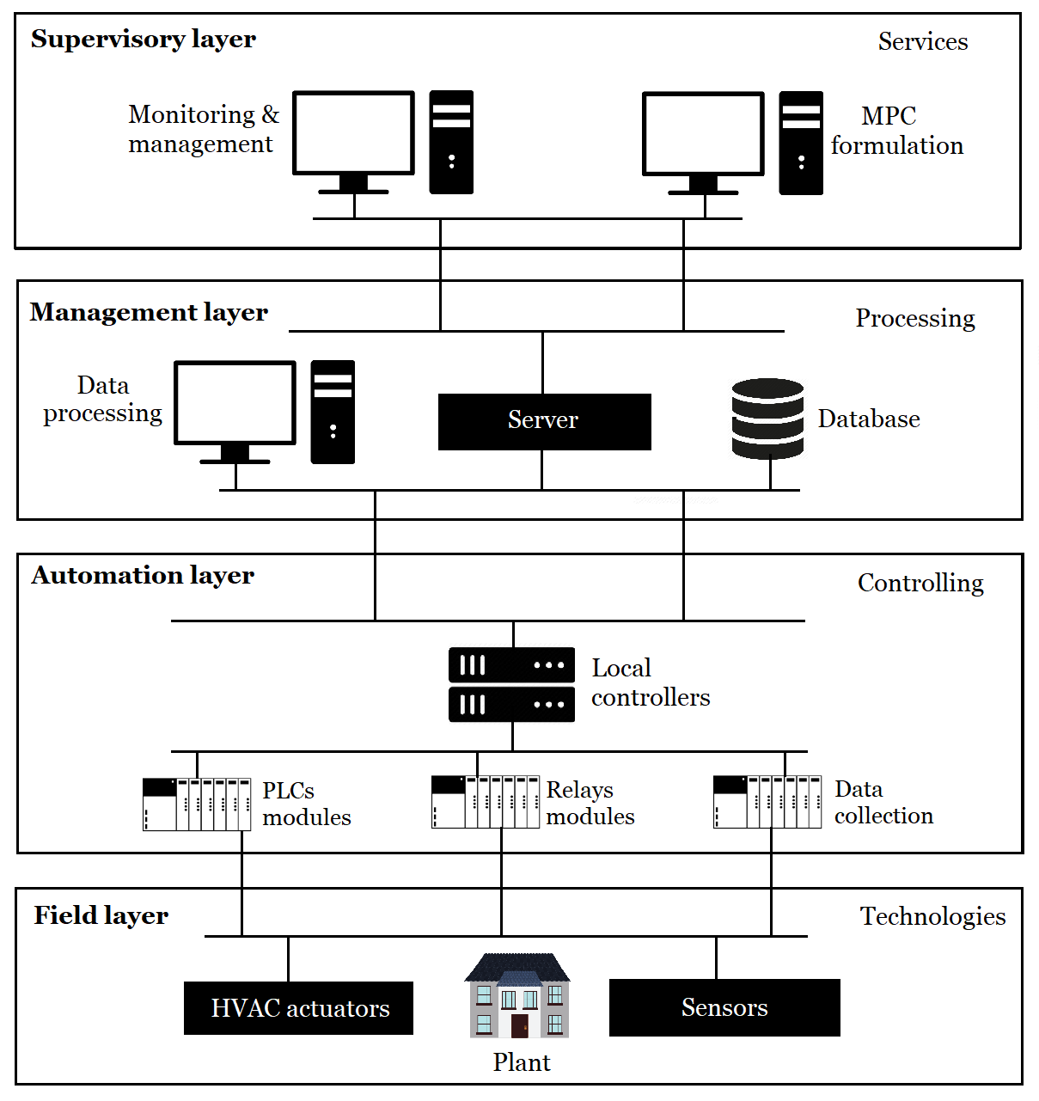





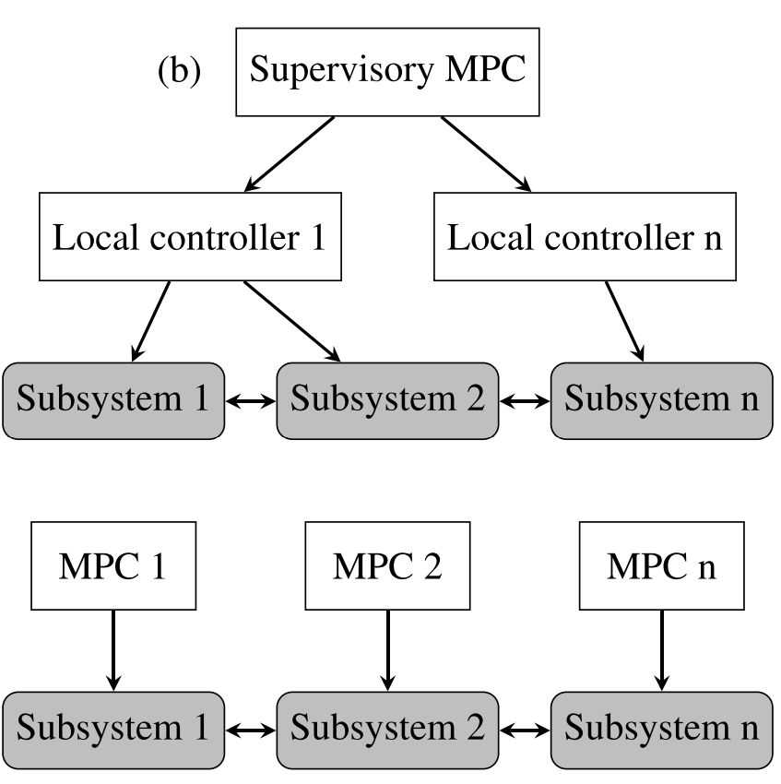



All You Need to Know About Practical Implementation of MPC in Buildings
Overview of Software tools
Control Configurations
SCADA Architecture
Notes:
Second part of the paper is focused on practical aspects of MPC deployment in practice this includes a comprehensive overview of available SW tools for modeling, control design, solvers, co-simulation, and SW integration tools
We review different control configurations used in industrial systems, together with detailed overview of SCADA architecture components from supervisory to the field level including details on communication protocols, data acquisition and storage, and deployment guidelines

Slide 6
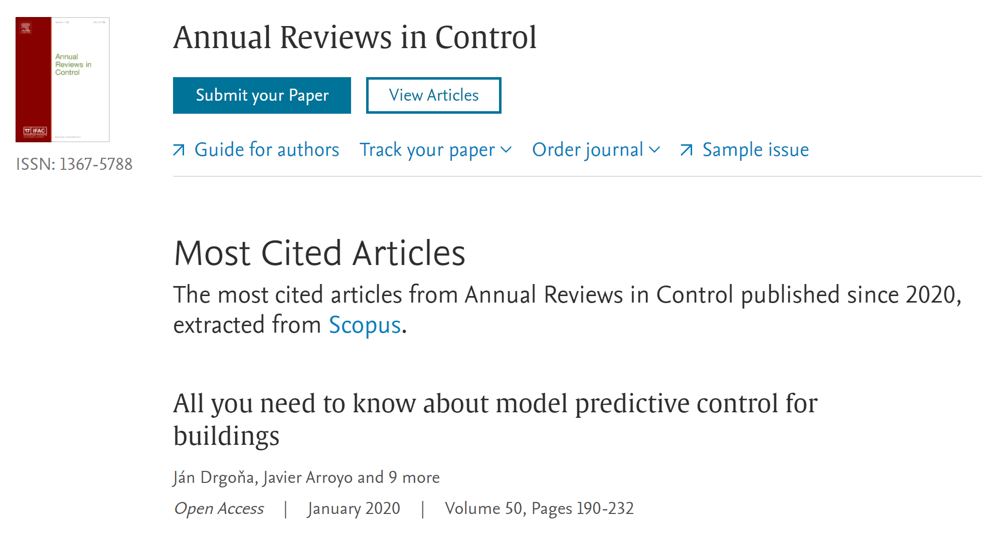




Broader Impact of Our Paper
Most cited article in Annual Reviews in Control
Total 271 citations up to date
Used world-wide as educational resource
Follow up papers published by co-authors of our review paper receiving two best paper awards
Drgona, et al., "Cutting the Deployment Costs of Physics-Based MPC in Buildings by Simulation-Based Imitation Learning“, Dynamics Systems & Control Conference, 2020
Blum, et al., "Building optimization testing framework (BOPTEST) for simulation-based benchmarking of control strategies in buildings“, Journal of Building Performance Simulation, 2022
Follow up funding from U.S. Department of Energy
Global impact beyond building and control community
Among others cited by Climate Change AI
“Tackling Climate Change with Machine Learning”
First author cited in NewScientist article
“DeepMind’s AI cuts energy costs for cooling buildings”

Slide 7








Acknowledgements
Scan for open-access:
Contact information:
jan.drgona@pnnl.gov
www.linkedin.com/in/drgona/
Notes:
contributions from all multi-institutional co-authors during the 2 years period of hard work
And generous support of our funding agencies that are supported development and open-access for broad accecisbility to our paper special thanks to..
Thank you very much for your attention

